Slide 1
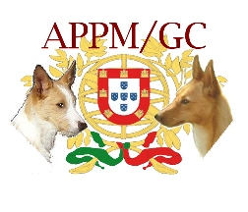
The Portuguese Podengo
A Happy Hunting Hound
An official presentation by the American Portuguese Podengo MedioGrande Club

Slide 2
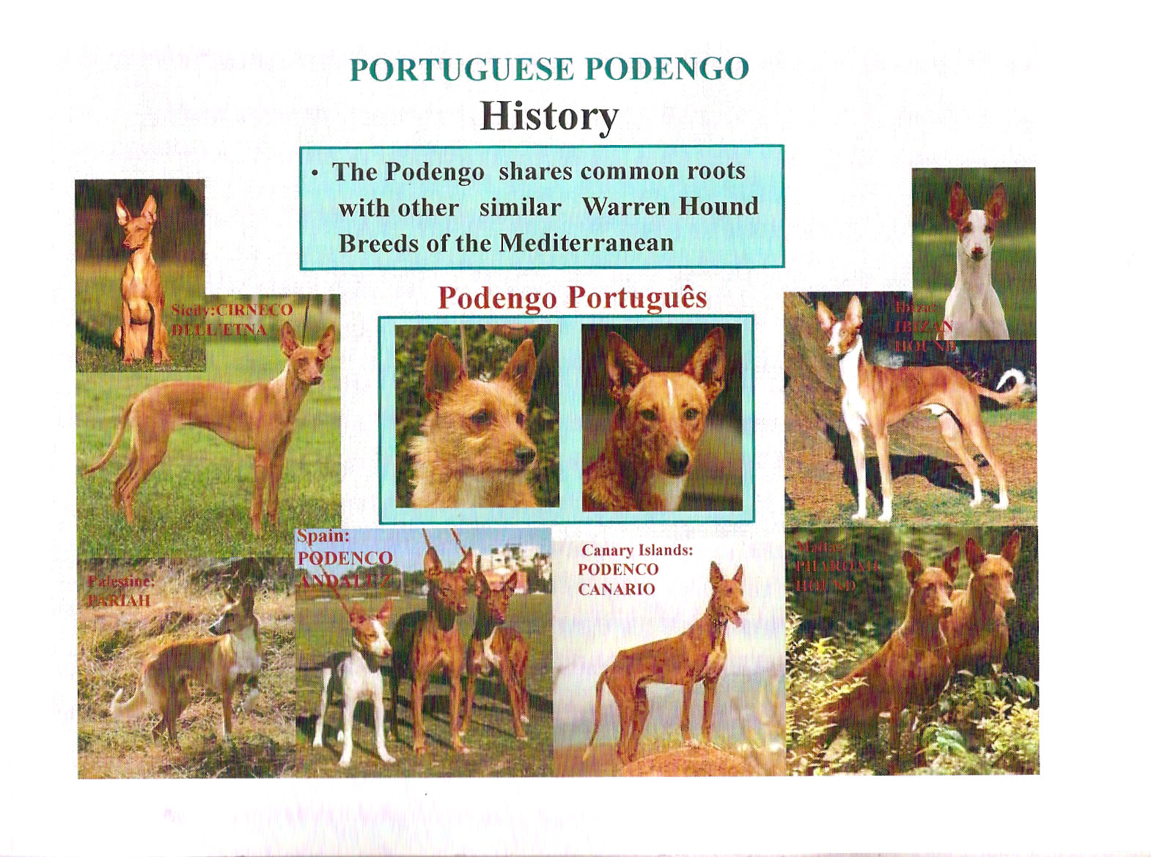

Slide 3
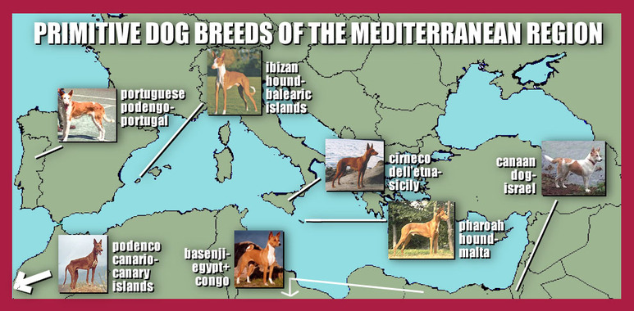

Slide 4
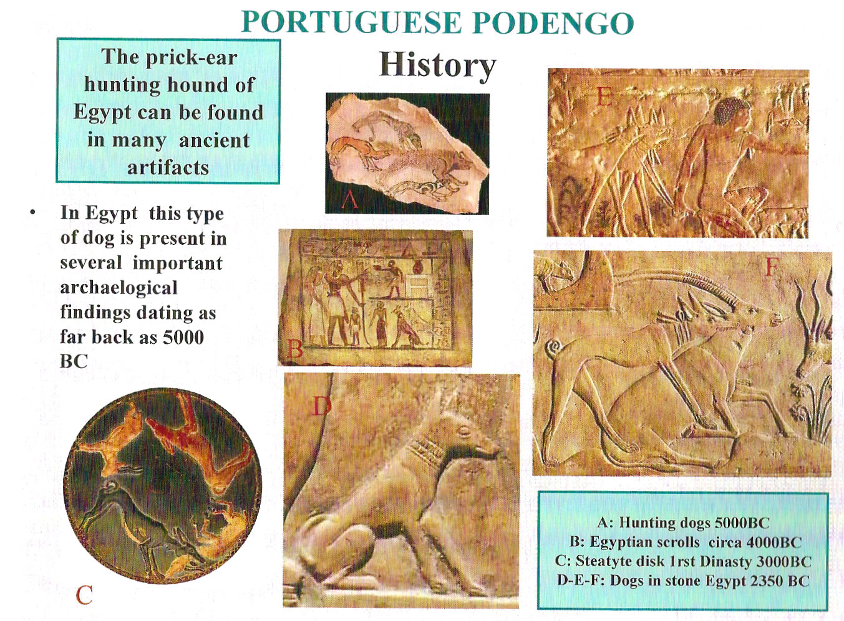

Slide 5
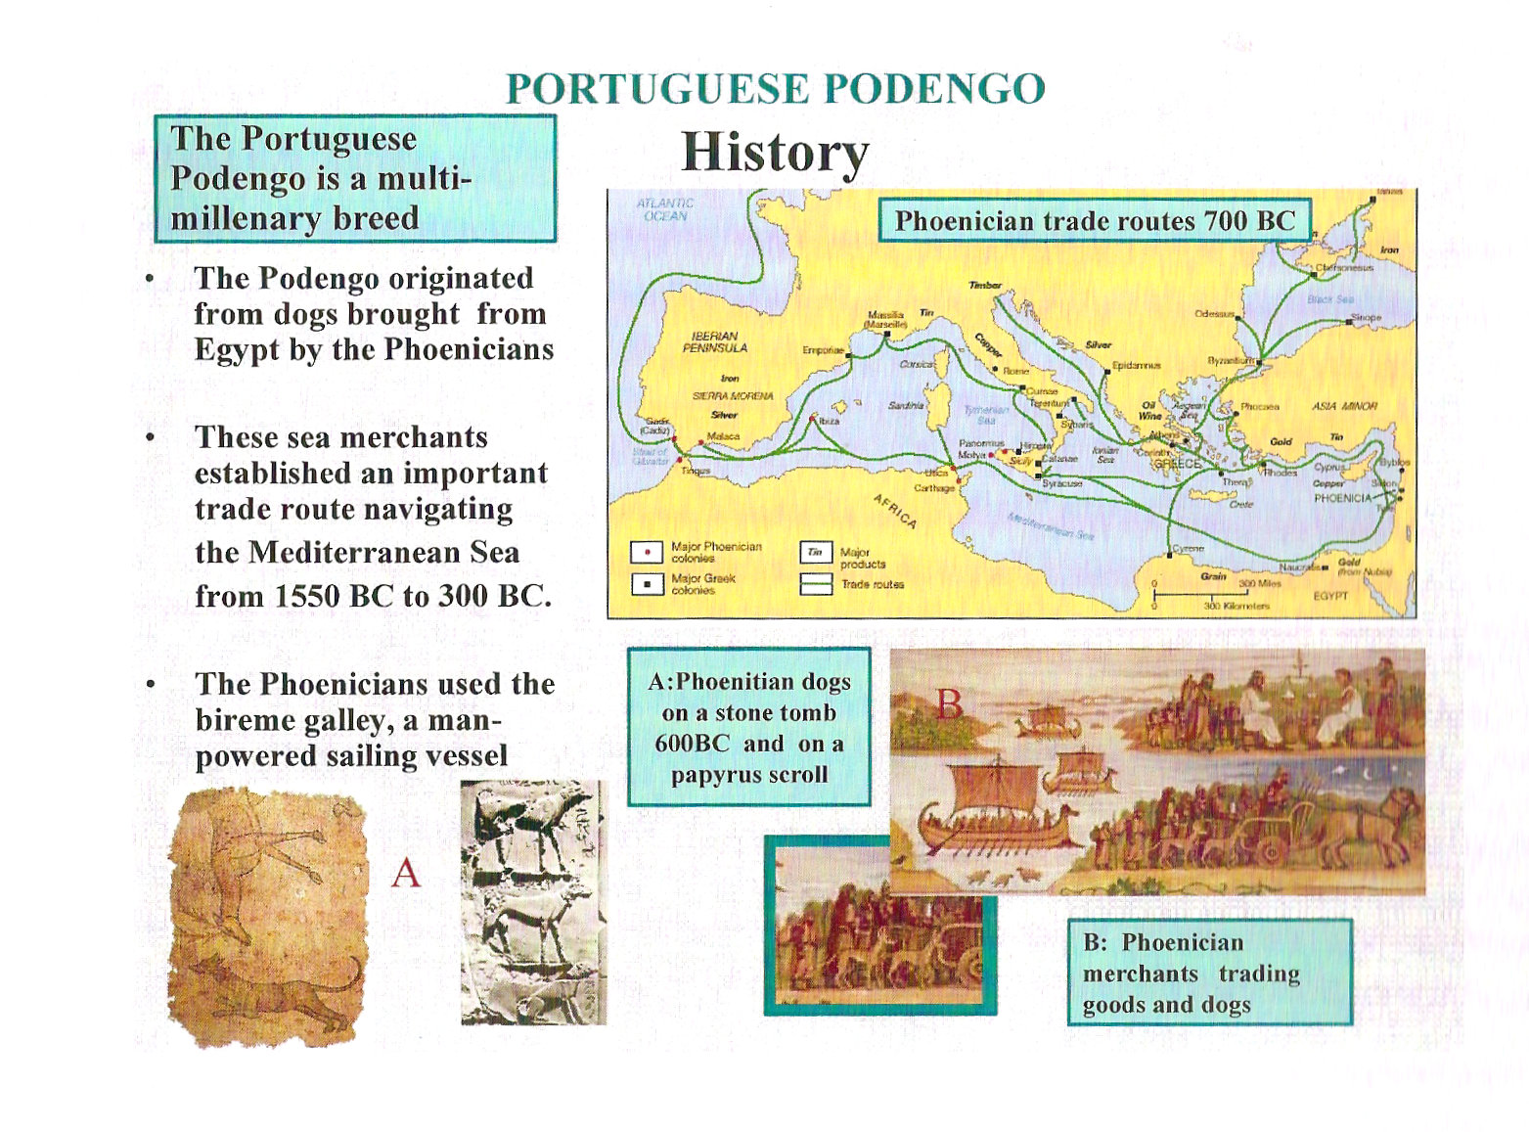

Slide 6
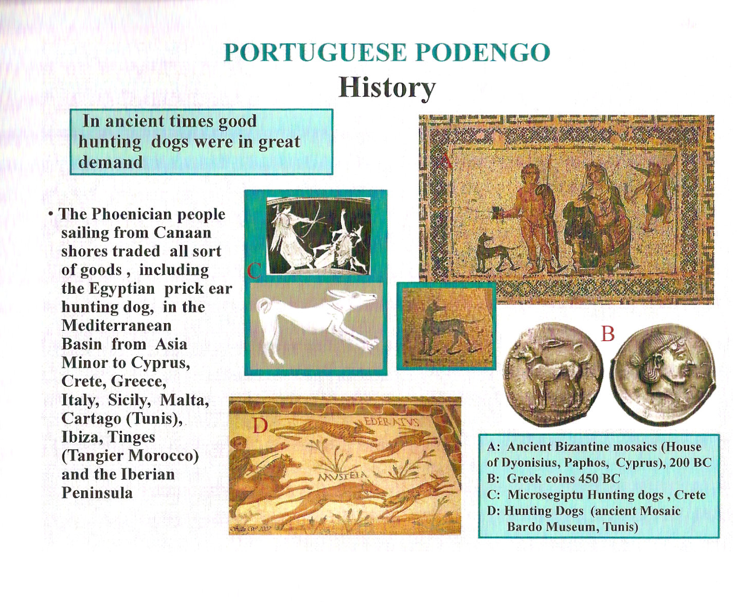

Slide 7
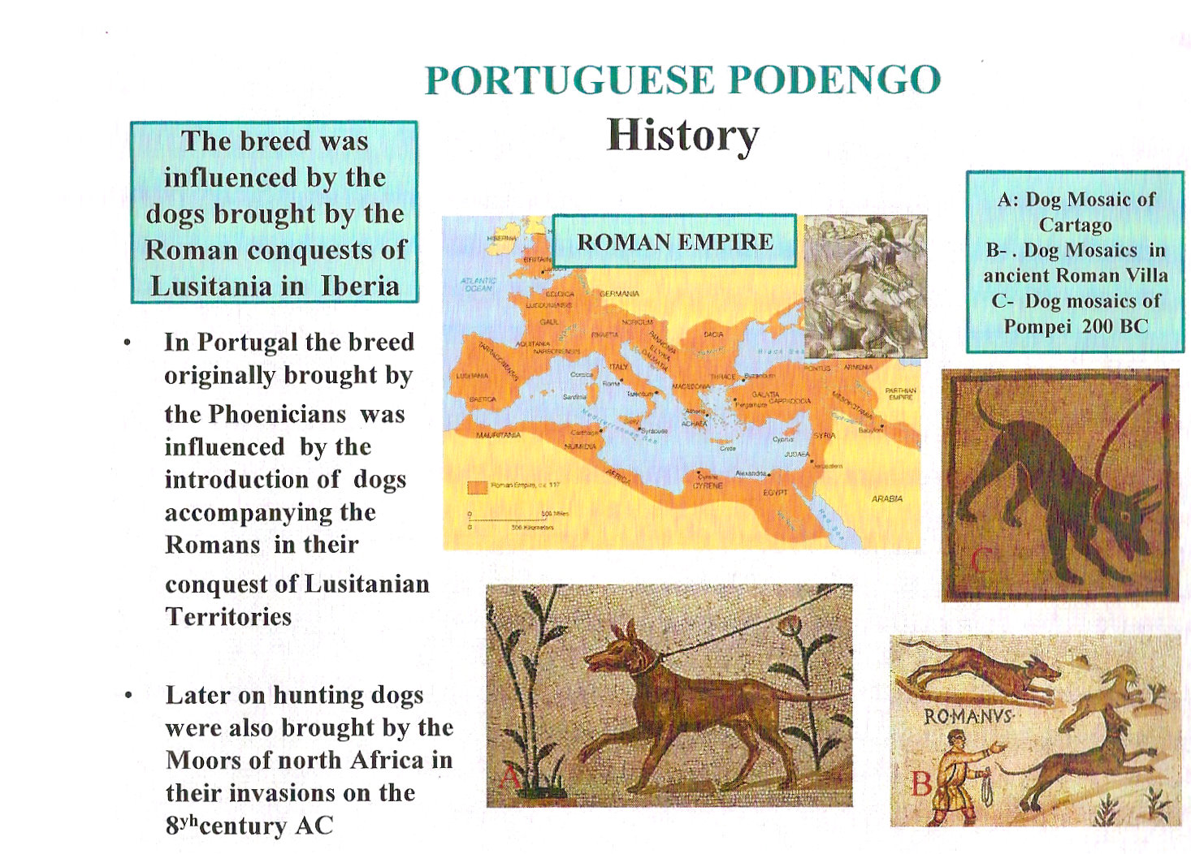

Slide 8
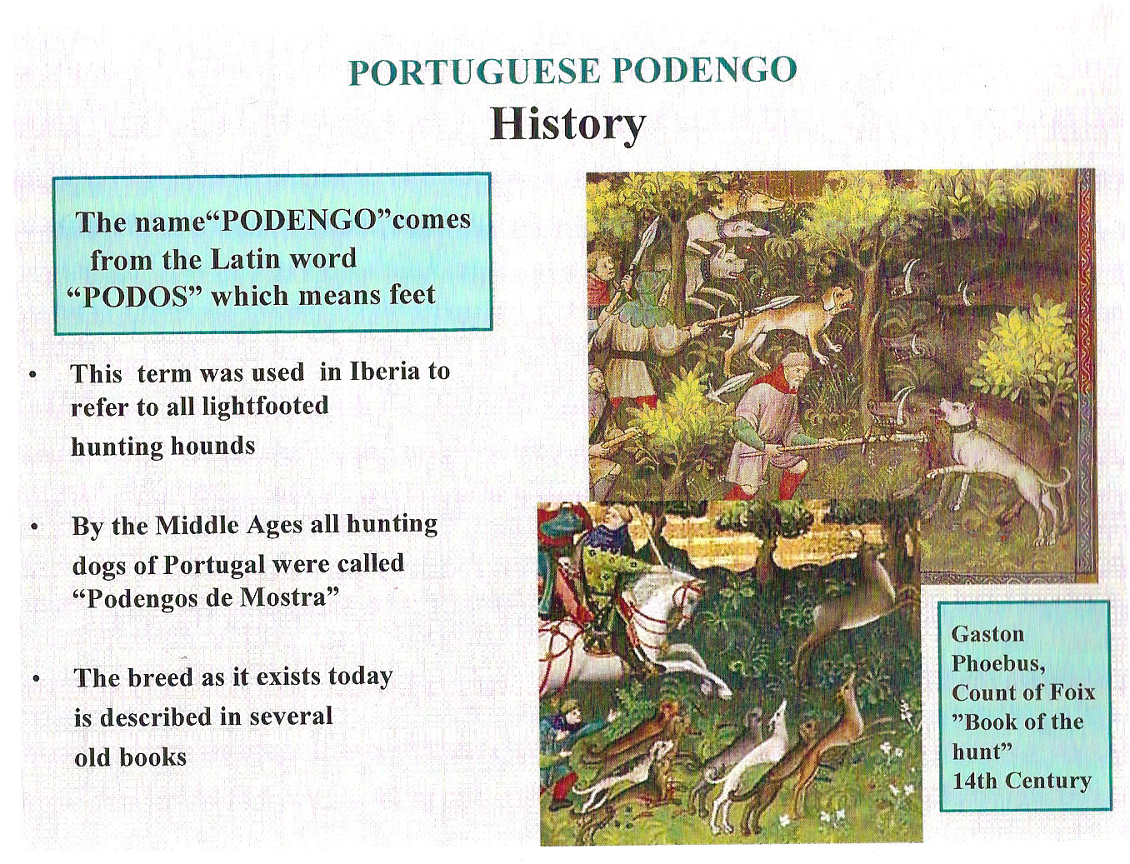

Slide 9
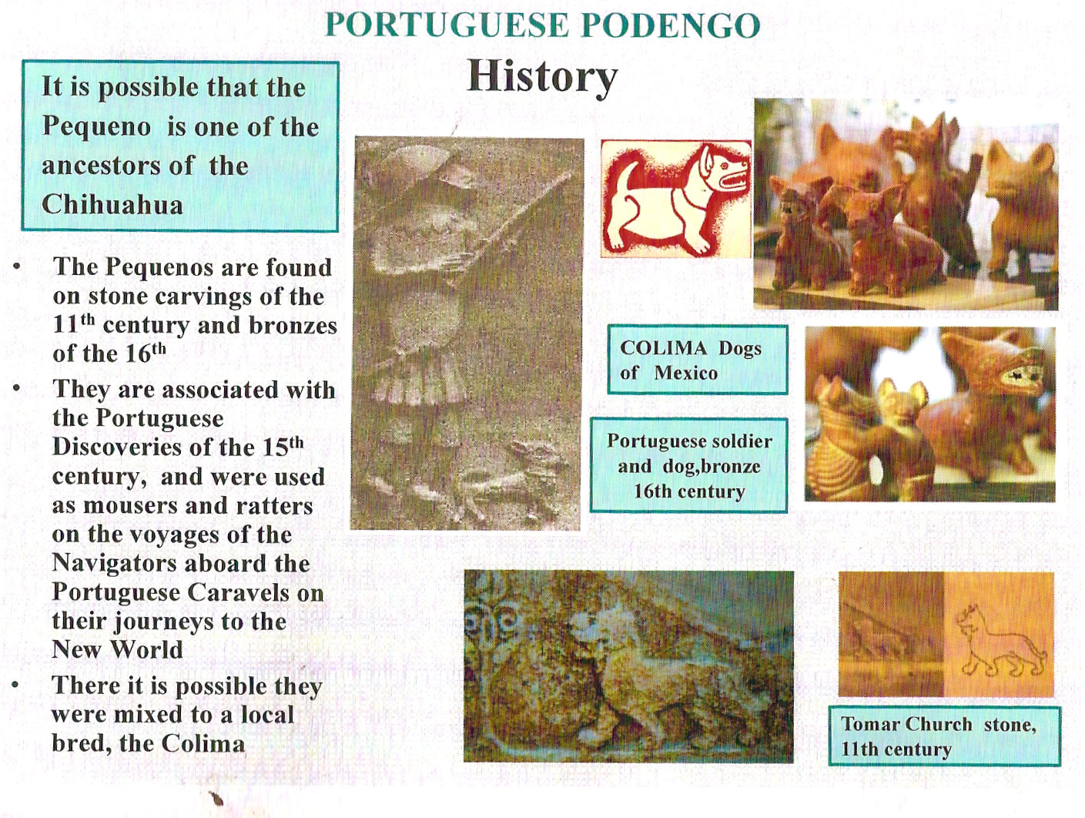

Slide 10
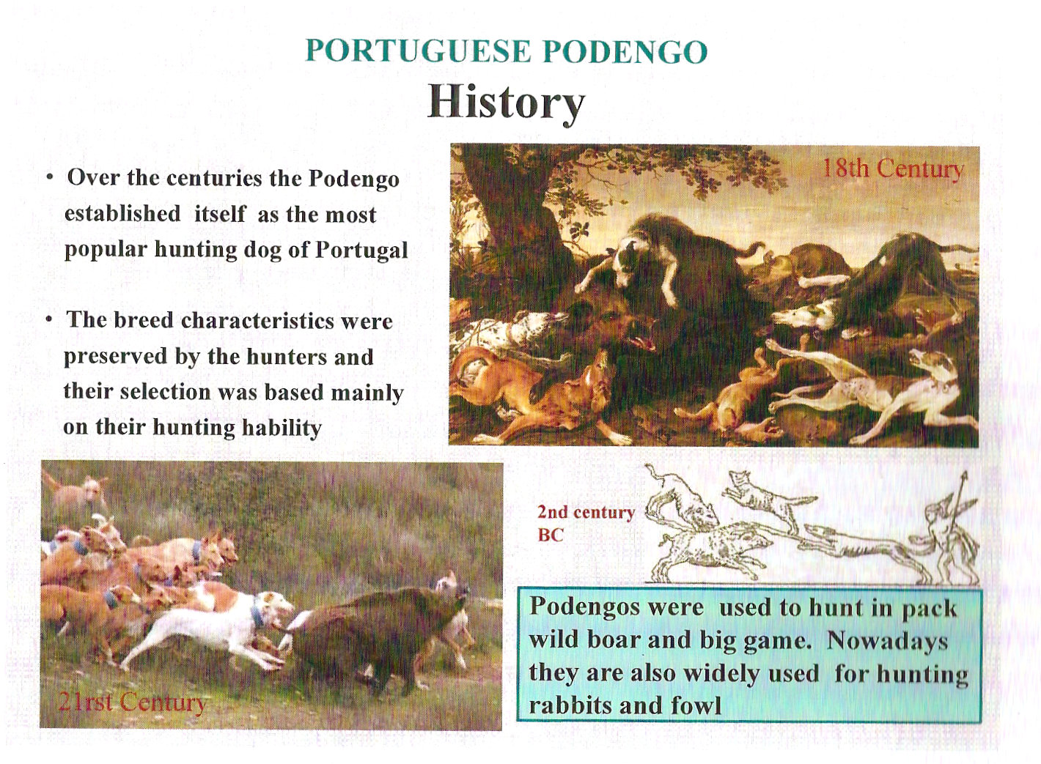

Slide 11
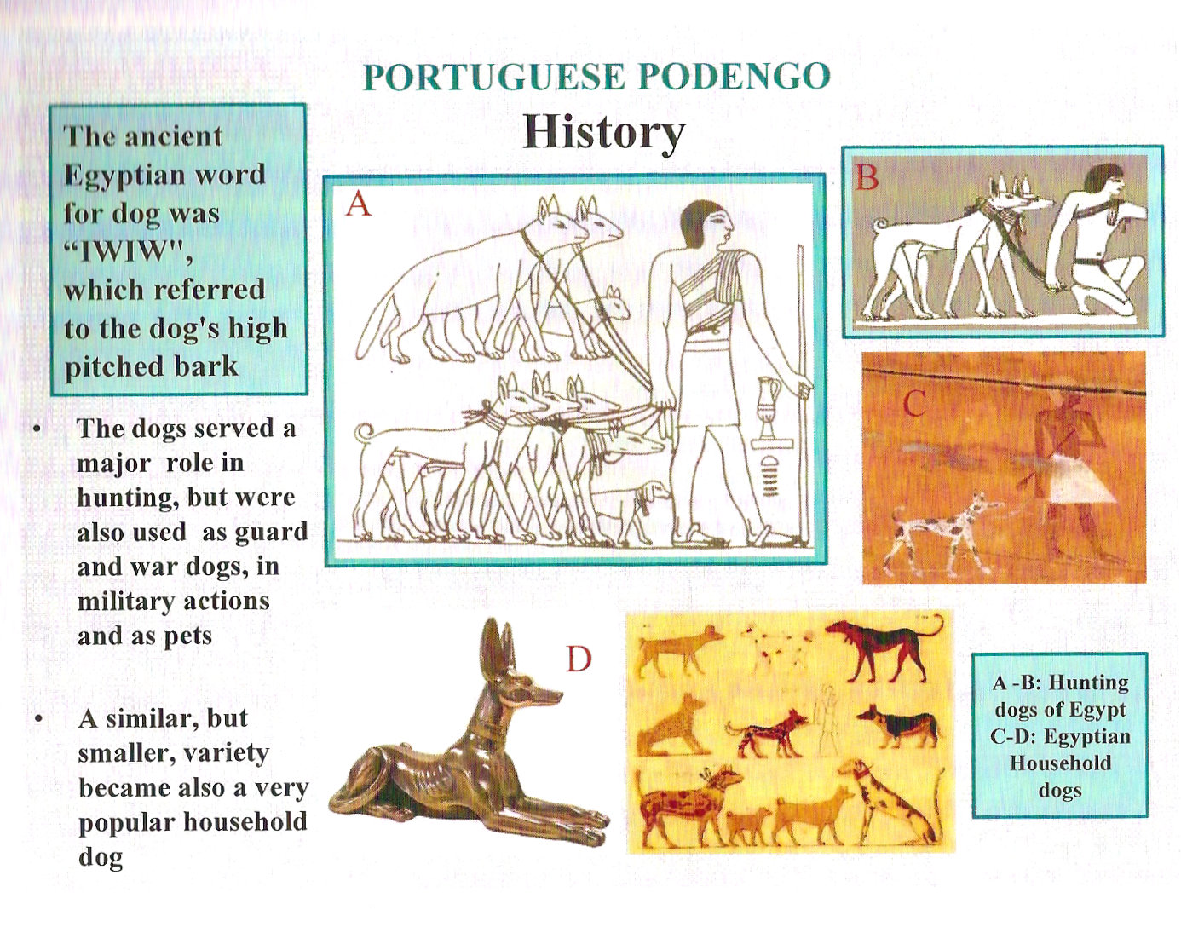

Slide 12
Typical Sighthound Right?
Clearly this history is one that can be repeated by many breeds currently being shown.
It does show the interconnectedness and common ancestry of in particular the Medio and Grande.
It also shows the division of purpose that many countries followed.
The Wire Pequeno however – had so few numbers in hunt packs that it was RESTORED by the Lisbon Zoo in the mid 1980’s.

Slide 13
The Challenge:
6 or 3 or 2 or 1 ?
Is it 6 breeds – 3 sizes 2 coats?
Or 3 breeds – only by size,
Or 2 Bigger Square together and Small rectangle together
Or 2 by coat (wire/rough & Smooth)
Or all sizes coats together and 6 varieties.
??????????????????

Slide 14
OTHER COUNTRIES:
In England – the Pequeno is the ONLY size that was brought over, is recognized and shown. The Kennel club recognizes the Peqeuno as the “Podengo”. The other sizes must go through the recognition process individually.
In Spain the Podengo Andeluse the smaller size (which is their version of the Pequeno) is split out as Maneto.“Maneto by its special morfoestructura is utilized exclusively in the small game hunting and more concretely in that of the rabbit. Is especially adapted to the Mediterranean scrub with bramble patches, streams and tight ravines. This thus due to their short extremities that qualify it perfectly to be unfolded in the lands of thick vegetation and those spots of difficult access and details of the land.”

Slide 15
WHY WAS THE PODENGO SPLIT INTO 2 BREEDS:
AKC defines a breed so that all sizes can be bred together.
While the Medio and Grande – can both be in the same litter and historically have been bred together. (think 13 & 15 inch Beagle)
The Podengo Pequeno is a rectangle – and has different proportions based on it’s function
Should be NO breeding with larger size!

Slide 16
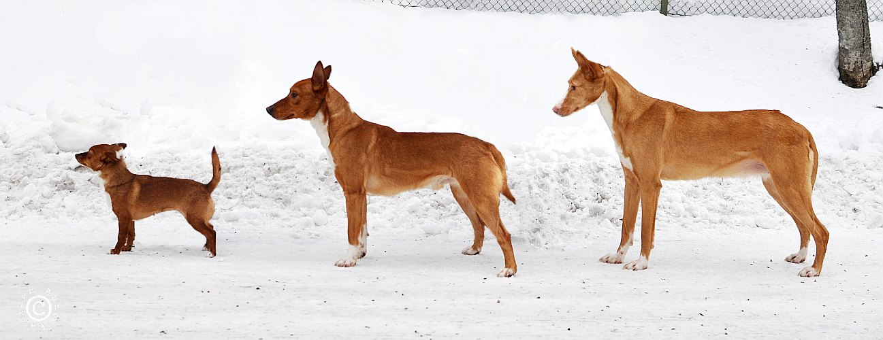
Breeding a more square long legged sight hound, open field runner with a rectangular – low to the ground dog that must be able to push through brush so needs a lower center of gravity would produce animals who could fulfill neither purpose. It is important to remember that the Pequeno is not a bred down from bigger sizes and the Medio and Grande are not bred up pequenos. The photo below provides general size difference.
Photo by Anna Räsänen – Permission given by photographer for APPMGC use for education.

Slide 17
Considerations:
FCI you are what YOU are – AKC you are what your parents are. (Just ask the Belgium Breeds about this one)
Wire and Smooth in same litter – well sometimes, maybe sort of.
Since you CAN and HAVE gotten big from medium and medium from big we needed to accommodate that.
FCI considers them more of a breed w/ variety and using their system 6 podengos go to the group. AKC has not done a ‘variety ‘ in 50 years. UKC says they judge like Portugal but only send 1 of the 6 to the group.
Hence the ONLY configuration that works in the AKC (and other US judging) system that also preserves the integrity of the breed is to have 2 breeds.

Slide 18
Split the Breed
In December of 2008 letter was submitted to AKC along with Pedigree documentation as well as the differences of the FCI and AKC rules on what defines a breed and how dogs are judged.
July of 2009 – Board action created 2 separate breeds. (better for the breed but meant that the bigger sizes would have to wait for numbers)

Slide 19
If form follows function…
…what’s the function!

Slide 20
It’s important to know what the function of the sizes are. If you have studied any breeds and their function at all – you already know what the breed should look like.
Really you do!
What do they hunt? What is the terrain like? The answers leads to the FORM of the dog you see before you.

Slide 21
The Rabbit!
The European rabbit is a smallish, grey-brown (or sometimes black) although it ranks as medium-sized by lagomorph standards. It ranges from 34 to 50 cm (13 to 20 in) in length, not counting a tail of 4 to 8 cm (1.6 to 3.1 in). Weight can range from approximately 1.1 to 2.5 kg (2.4 to 5.5 lb). As a lagomorphs, it has four sharp incisors (two on top, two on bottom) that grow continuously throughout its life, and two peg teeth on the top behind the incisors, dissimilar to those of rodents (which have only two each, top and bottom). It hides in dense cover.

Slide 22
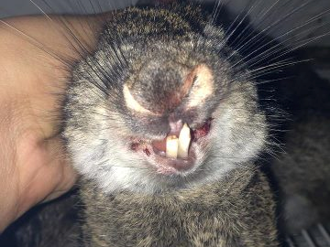
Teeth - Sharp: Body 13-20 inches long.
What do you know about the substance, hardiness or strength of the dog that can catch and carry this?

Slide 23
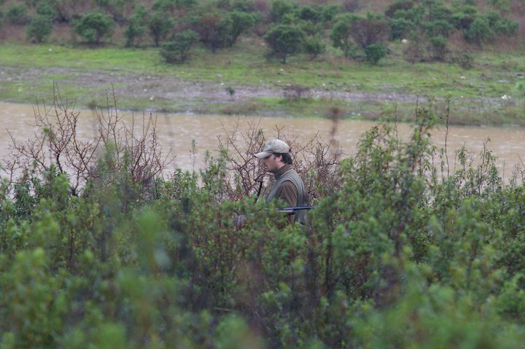
What structure do you need to push through this?

Slide 24
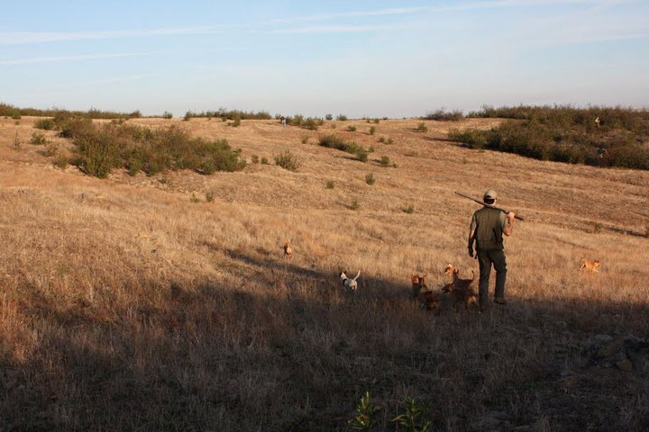
Or run across this?
Long or short legs? Efficient effortless gait – Gallop?

Slide 25
The Boar
The male boar is bigger than the female in stature and tusk length. weighing an average of 80kg (176 lbs), rarely attaining 120kg (264 lbs). The average length from head to tail is 120-170cm 47 -66 inches) and average height at the withers is 48-69cm (18 – 27 inches).
The male wild boar has stocky body with relatively thin legs, a short neck, and a long snout. The upper tusks grow outward and backward and the lower ones grow upward and backward, forming a circle. Tusks will wear against each other and develop very sharp edges.
In Portugal, hunters congregate in various-sized groups called ‘Montaria' and hold hunting drives with beaters and dogs.
Wild boar hunting in Portugal may also be done from a blind. It is allowed for 10 nights per each lunar month - 8 nights before full moon, the night of the full moon and the following night only.

Slide 26
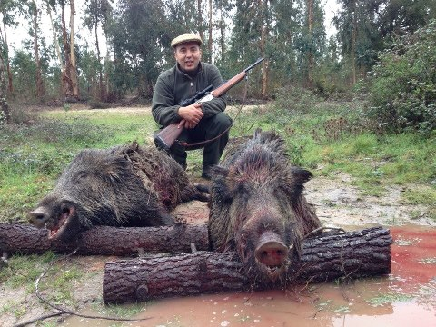
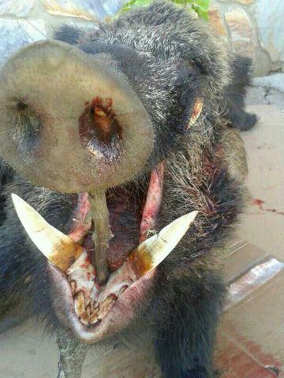
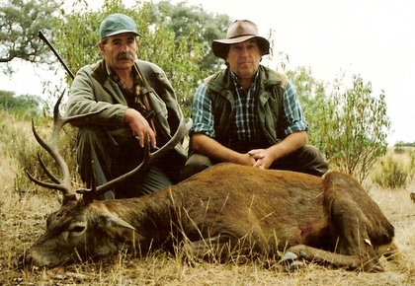
What if this is waiting for you?

Slide 27
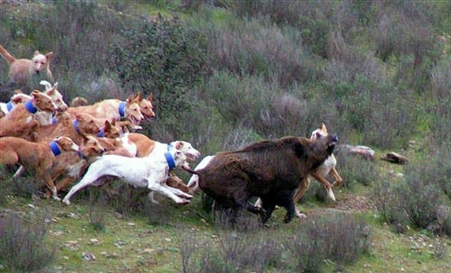
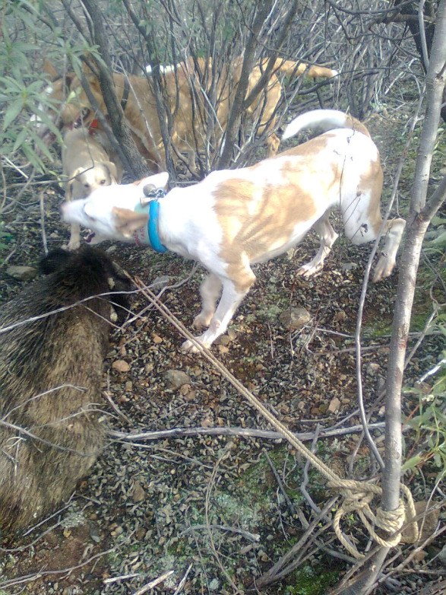
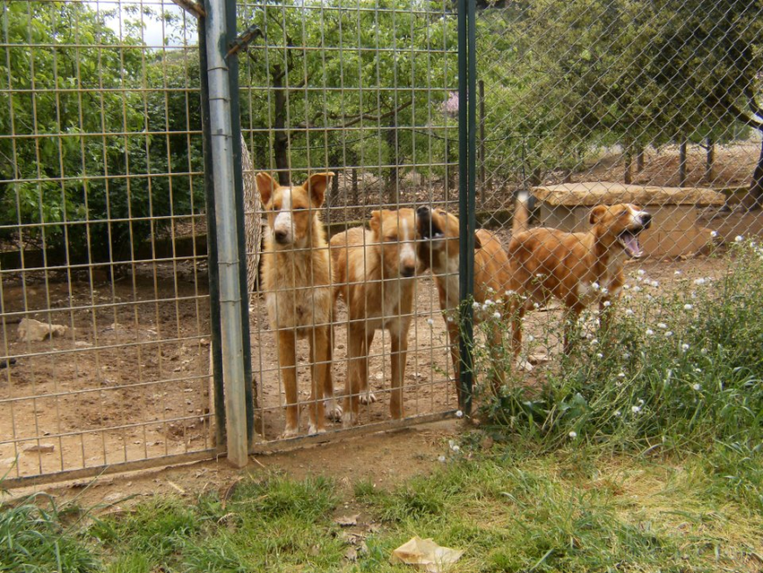
Courage, Speed, Substance,

Slide 28
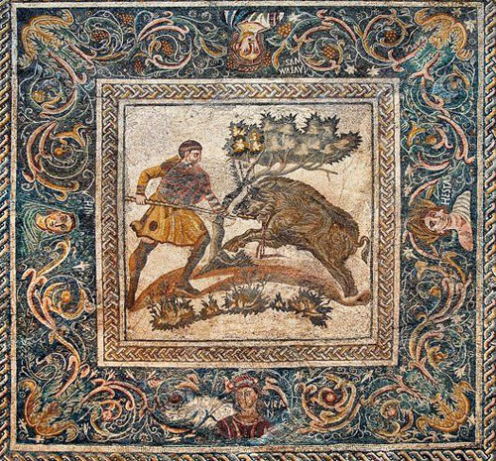
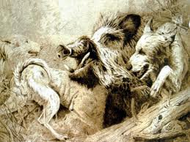

Slide 29
So now that you know that the Pequeno – needs to push through brush and bring back a rabbit for the family meal – you are better able to know what are the ‘functional priorities”
Substance in a small package, Sturdy, Height at withers equally divided between depth of chest and length of leg. Longer than tall. Alert, attentive, with highly mobile ears.
Podengo(Medio/Grande) More square – open field runners, agile, alert. Stamina and strength for running down Rabbit, and add substance in the largest sizes for Stag and Boar.

Slide 30
The Podengo Medio and Grande
The Standard in pictures and words:

Slide 31
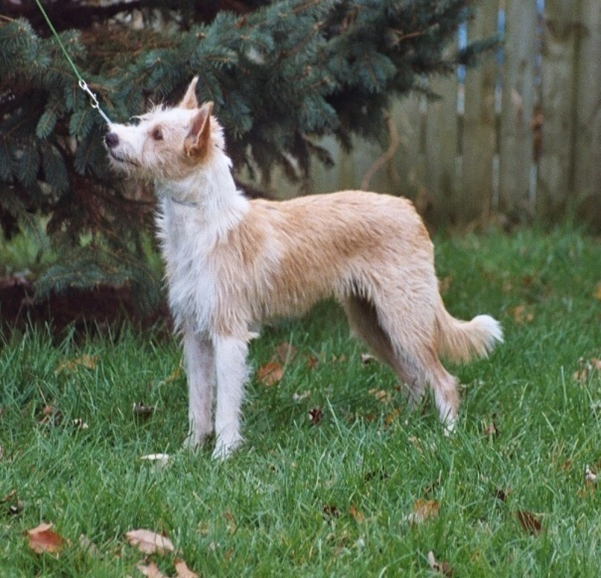
The American Portuguese Podengo Medio Grande AKA
PODENGO
Origin: Portugal
  Portuguese National Breed
Utilization:
  Rabbit and large game hunting, watch dog & companion
Classification:
  Current AKC – MISC
  Proposed AKC: Hound
  FCI Group 5
  KC: Hound
Notes:
Primitive Hounds of Portugal that are exhibited as 6 individual breeds in FCI. Small Smooth, Small Wire, Medium Smooth, Medium Wire, Large Smooth and Large Wire.

Slide 32
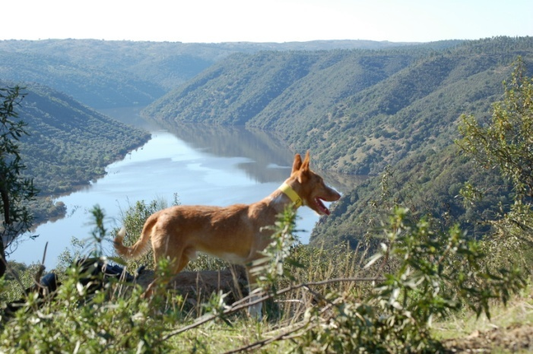
Brief History
Primitive type dog
Probable origin lies in the ancient dogs brought by the Phoenicians & Romans to the Iberian Peninsula in antiquity.
Adapted to the Portuguese territory & climate,
From the 15th century on, the Medio and Grande were used as hunters for rabbit and large game.
Today the Grande size exists primarily in hunting packs.
The Podengo is the most common hunting dog in Portugal
Notes:
The breed shares a similar history with other primitive breeds found in the Mediterranean region such as the Podengo Ibicenco, Podengo Canario, Pharoah hound and Cinerco dell Etna. The Podengos developed into different sizes in Portugal, the largest being the “GRANDE” which was developed for deer and wild boar hunting. It will exhaust and detain large game and await the hunter's gun. The Grande is now very rare in its home country. In the US there is a total of …..one.
Developed for rabbit flushing, chasing, catching and retrieving, the knee-high MEDIO has a hunting style which includes cat-like stalking and, similar to the Spanish Ibizan Hound, it often jumps above the prey before landing on or near it to flush it out of dense brush or rocky crevices. It will dig if necessary to flush prey.
.

Slide 33
Used For:
The GRANDE was developed for deer and wild boar hunting. It will exhaust and hold down the prey and await the hunter's gun. The Grande is now very rare in its home country.
The MEDIO was developed for rabbit chasing, flushing, hunting and retrieval. Its hunting style includes catlike stalking and, similar to the Ibizan Hound, it often jumps above the prey before landing on or near it to flush it out of dense brush, rock crevices or burrows. It will dig if necessary to flush prey.
Both size varieties are respected as versatile hunters and companions that use all their senses as well as agility, speed and endurance, running singly or in packs.
Notes:
Medium and Large may hunt together in packs for large game, for boar however you will likely see the Grande size along with some other large powerful hunting breeds.

Slide 34
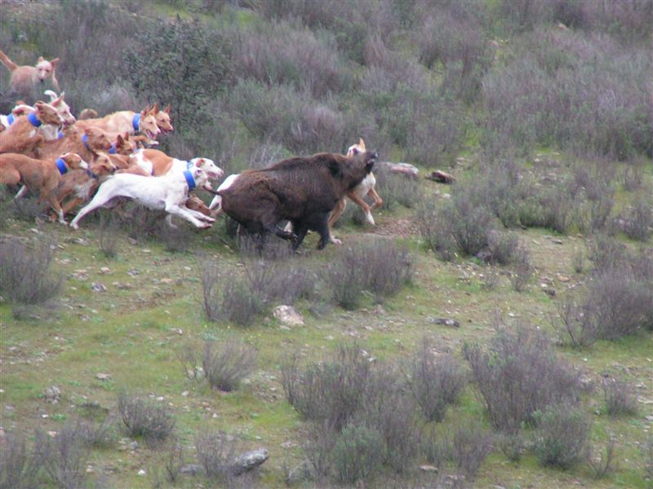
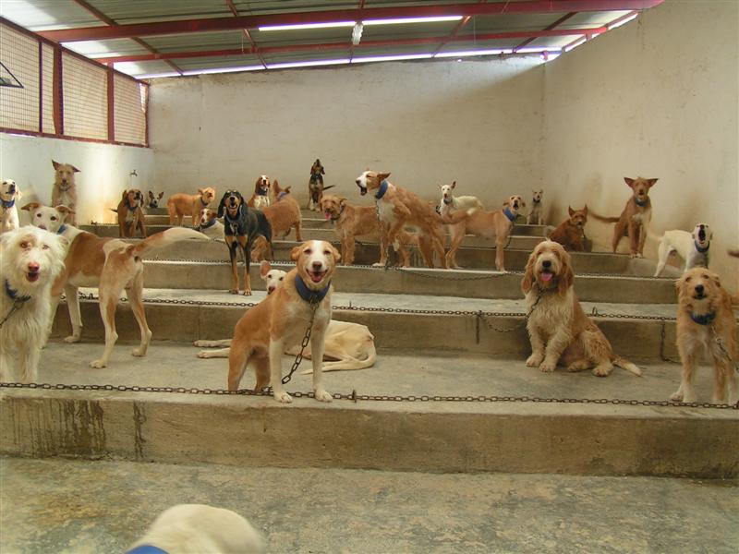
Grande Hunt Pack
Notes:
To illustrate the primitive nature and hunting lifestyle of the Podengo in Portugal this slide shows Grandes during a Boar hunt. The second image shows how the hunt pack (this one is a mixed pack) are housed at the kennel. Each hound is chained inside this building. After the hunt those who survive – come back to their ‘kennel’. The ‘Bigs” are seldom considered house pets in the country of origin although they take to it very well.

Slide 35
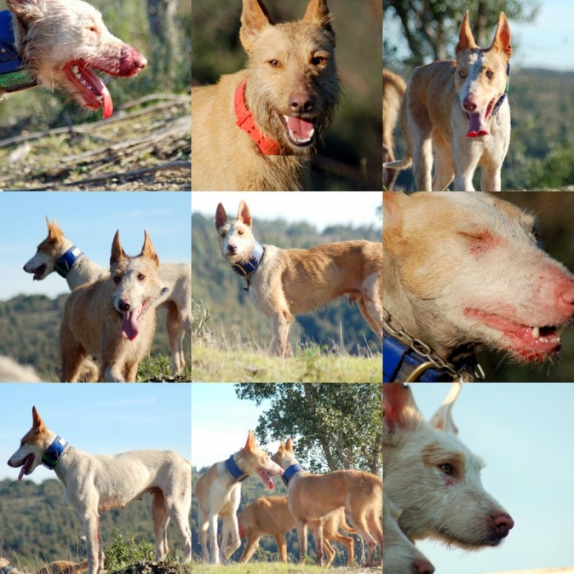
Notes:
On the job - some images from hunting pack Grandes in Portugal.

Slide 36
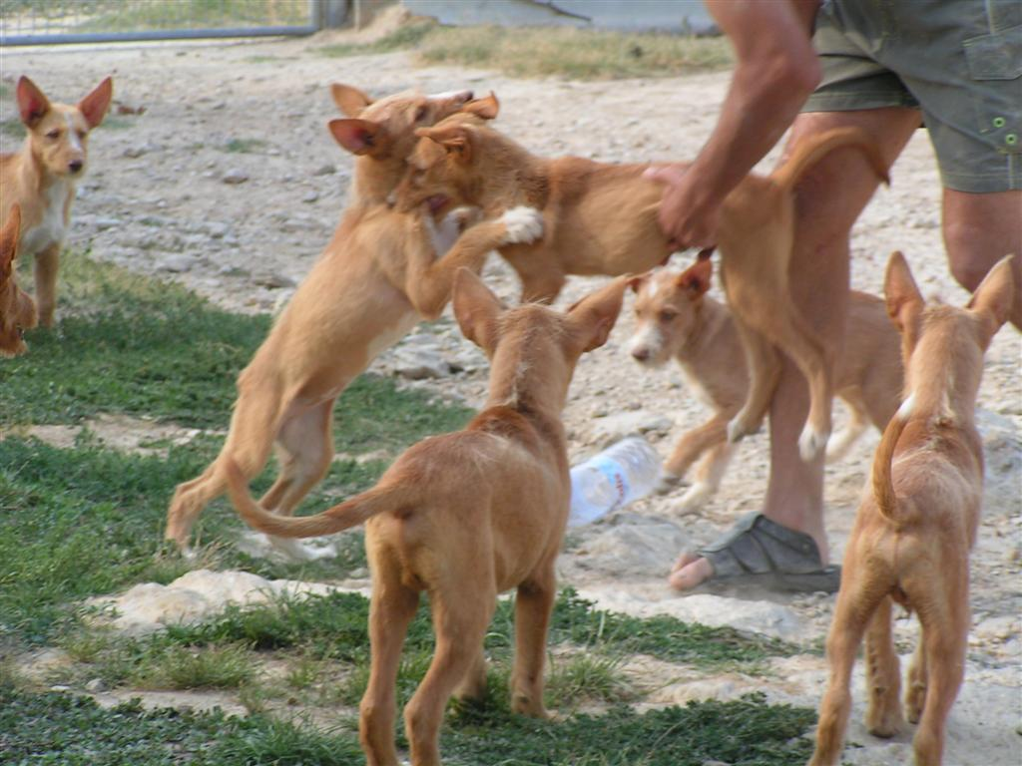
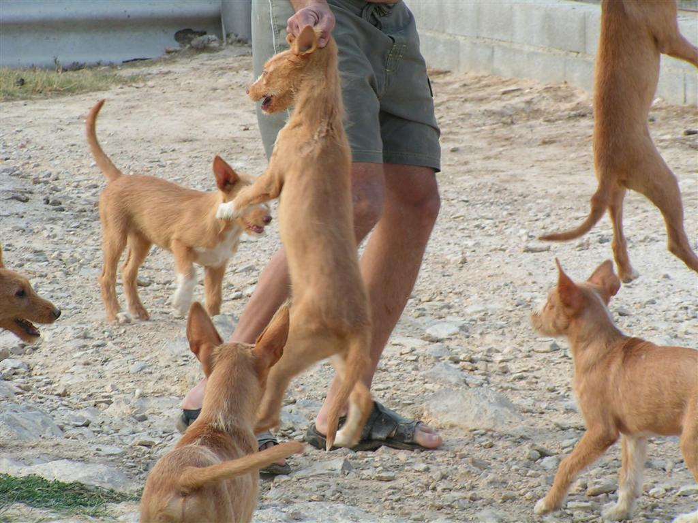
Grande
Pups
It is important that pups learn manners –although we may not agree with this method – it has a purpose in the pack.
Notes:
Here we have Grande wire puppies testing their hunting skills on each other and the hunter breaking them up by carrying them off.

Slide 37
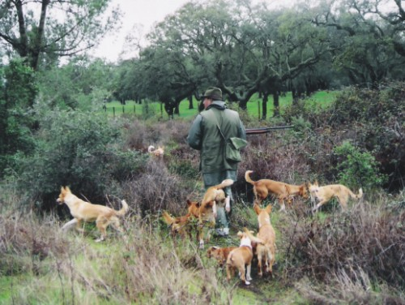
Mixed Pack in Portugal
Notes:
It is not be unusual to see mixed sizes of Podengos hunting Rabbit.

Slide 38
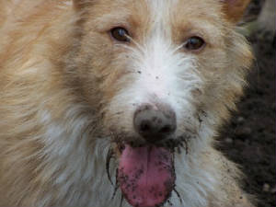
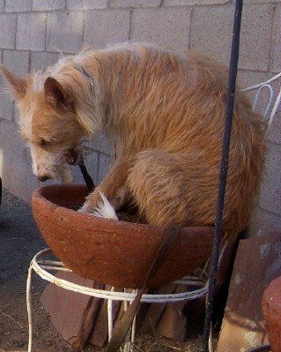
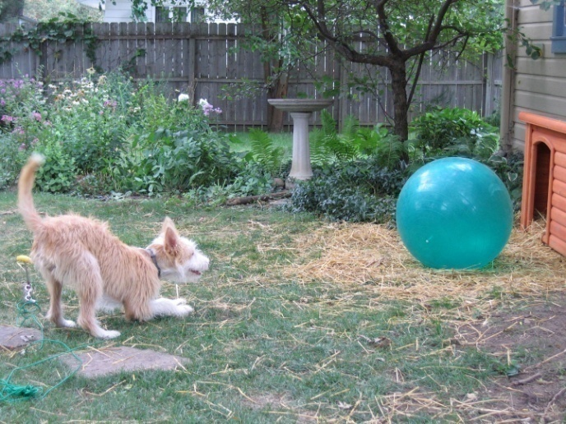
Behavior - Temperament
Podengos are great watchdogs & companions.
Lively & clever, agile affectionate, happy, loyal, attentive, fearless & very playful.
Quick to learn but not always easy to train.
May be reserved with strangers.
They will both surprise and test the unprepared owner.
Notes:
Podengos in general are very lively, active, funny dogs that love to play. They do however require firm training or they will find their own adventures.
They easily entertain themselves with toys, chase each other and stalk each other around the house and yard. They are highly intelligent and easily motivated by food and fun so they can learn new things quickly. They are generally tolerant and compliant, eager to please their family members and put up with most requests we make of them. They do however, require consistent and fair training or they will come up with some pretty creative adventures on their own. Since they are a watchful dog, Podengos are not as easy going and playful with strangers. They may be quite reserved or suspicious initially and prefer to greet strangers on their own terms.

Slide 39
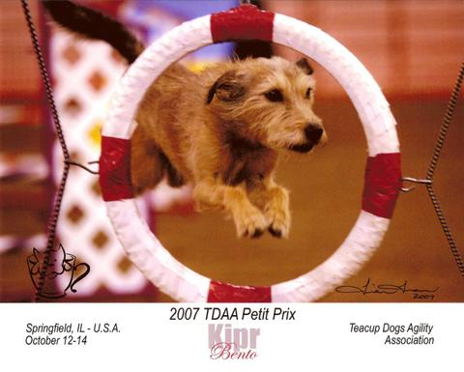
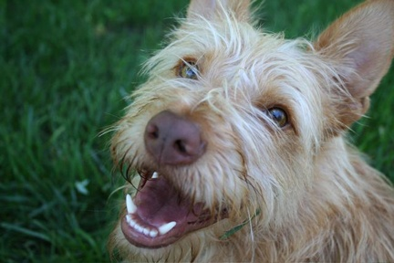
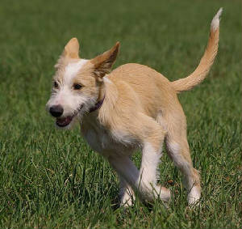

AKC Performance events
Notes:
An AKC FSS breed, as of January of 2008 they became eligible for AKC companion events. We are seeing dogs obtain, rally, tracking, and lure coursing titles. As well as those that are competing in other show venues that are open to them in Conformation like: UKC, IABCA

Slide 40
General Appearance
Quadrangular pyramidal head, with prick ears.
Sickle tail.
Well-proportioned body slightly longer than tall.
Sound skeleton & well muscled.
Lively & intelligent; wary & alert with highly mobile ears that are alert for prey not funny noises or candy wrappers.
Exists in the Smooth & Wire-haired varieties.
Notes:
The Podengo standard for all sizes was originally written based on the Medio’s found in Portugal since at the time, they were the most plentiful dogs.

Slide 41
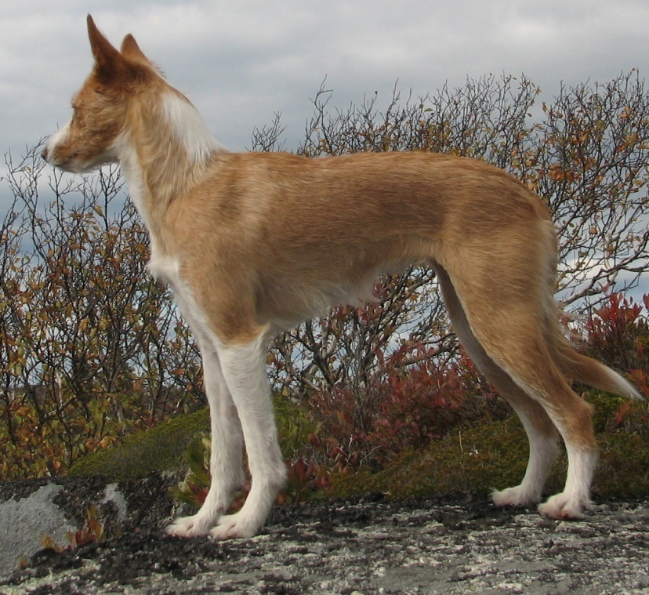
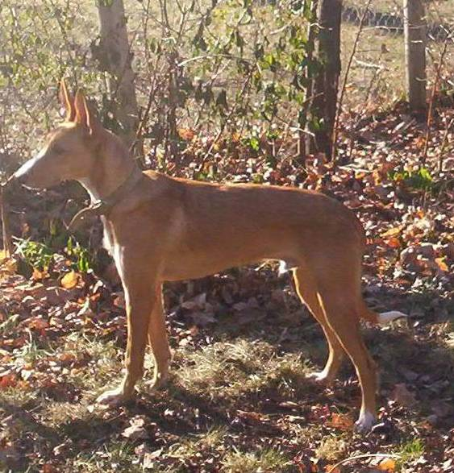
Proportions
Slightly longer body length than height with a relation - body length/height at the withers: 11/10
Chest should be down to the elbow
The muzzle length is shorter than the skull length
Notes:
We are looking for a good balanced slightly longer than tall animal. Since puppy growth for these bigger sizes are uneven – it is probable that some younger dogs will look either longer than tall or taller than long at various times in their development.

Slide 42
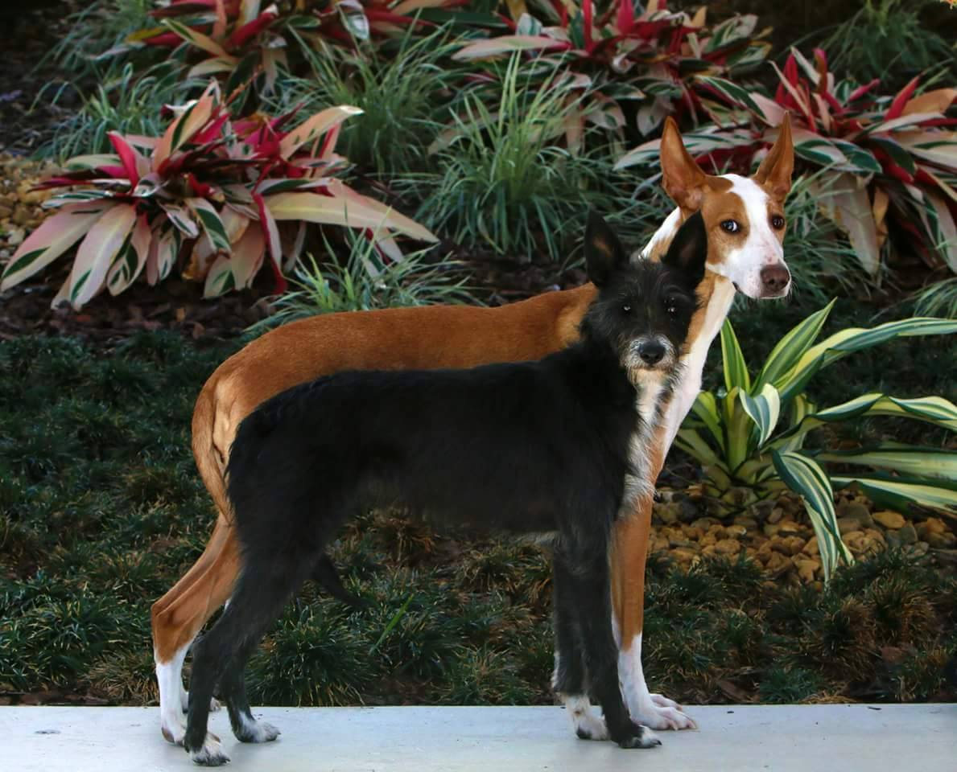
Compare Medio and Grande

Slide 43
Height - Weight
The proportions of the Grande and Medio are almost square. Strong in build. Body length from prosternum to point of buttocks is approximately 10% longer than the height at the withers.
GRANDE: 22" to 28" at the withers, 44 to 66 lbs
MEDIO: 16" to 22" at the withers, 35 to 44 lbs
They are examined on the ground.
DQ - SIZE UNDER 16”

Slide 44
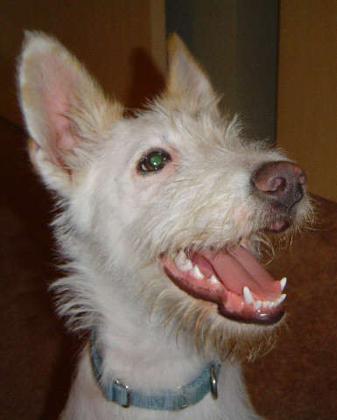
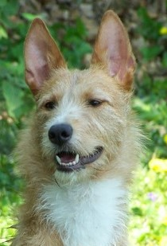
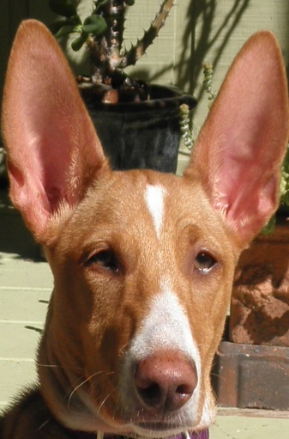
Head
Lean, fine, flat or slightly arched skull.
Shaped like a 4-sided pyramid, tapering towards a slightly protruding tip.
Occipital bone slightly prominent.
Stop barely defined.
Nose:
  Nose Color is always darker than the coat
Notes:
The head is expressive, happy, worried, excited, scared, intent – you will never wonder what they might be thinking – they wear their expressions in the open. When well socialized, they are outgoing and can be somewhat of a pest.

Slide 45
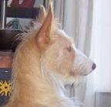
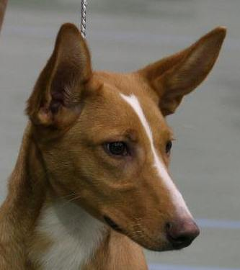
Muzzle: Curved, with a straight profile; shorter than the skull; broader at the base than at the tip.
Lips: Close fitting, thin; firm, opening horizontally and well pigmented.
Jaws/Teeth: Normal with scissors bite, with white solid teeth.
Cheeks: Lean and obliquely set.
Eyes: Very expressive, moderate in size, not prominent, set obliquely, color varies according to coat color, from Honey to Brown.

Slide 46
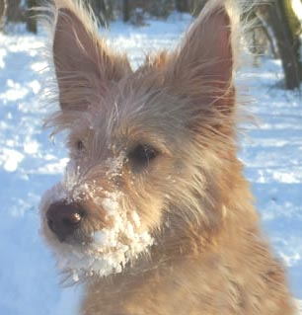

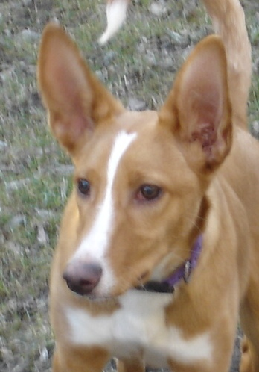
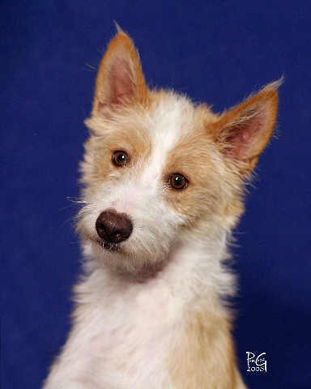
Ears:
Large, thin, triangular shaped, broad at the base tapering to a fine point.
Set on medium high and obliquely.
Lift at the base, always very mobile, typically carried erect however many times moving to assess environment. Length of ear greater than width at set on.
DQ –Drooping hound ears
Notes:
The ears on a Podengo are always in motion. They can hear an “ant walking under ground” essentially. Their hearing is extremely sensitive, their sense of smell is remarkable and their keen sight helps them lock in on whatever critter they have locked in their sights. This is a sensitive breed and they wear their emotions in full view.

Slide 47
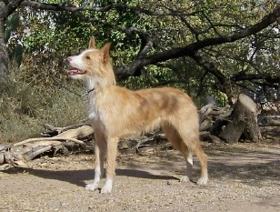
Body shape
Neck: With a harmonious transition from head to body; Straight of medium length, strong and well-muscled, clean throat line.
Top line: Length of body slightly greater than height at withers. Topline typical sighthound straight or slightly arched over loin.
Body: Ribs moderately well sprung and well carried back. Chest moderately deep and not too wide. Fore chest slightly accentuated. Underline slightly rising.
Croup: Straight or slightly sloping; medium sized; broad and muscled.
Chest: Down to the elbows; of medium width; long, with the sternum sloping back and up; ribs slightly arched and slant; breast not too prominent and muscled, not very broad.
Bottom line and belly: Slightly uprising; lean belly and flanks, slightly tucked up.
Tail: High set of medium length, thick at the base tapering to a fine point. Curved over the back when moving. Hair fringed on its under side.
DQ -Tail curled over, touching the back
Notes:
Again, the body is only slightly longer than the dogs height. A too long dog or a dog with a great deal more leg than body is also not preferred.

Slide 48
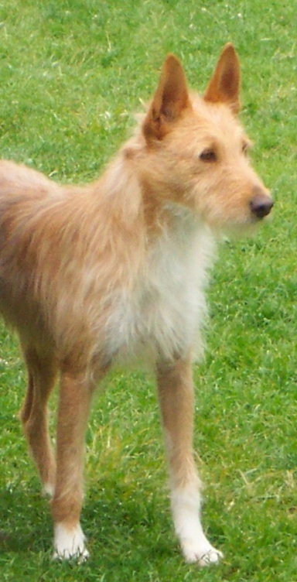

FOREQUARTERS: Upright when seen from front and side; well muscled and lean.
SHOULDER: Long; oblique; strong and well muscled; open shoulder angle, approximately 110º.
ELBOW : Parallel to the axial body plane with forearm vertical, long and muscled.
CARPUS (Pastern joint): Lean and inconspicuous.
METACARPUS (Pastern): Short; strong; slightly slanting.
FORELEGS: Strong round feet, toes tight and well arched. Nails strong and short. Firm pads. Absence or presence of front dew claws is immaterial in the judging of the dog.
Front
Notes:
Straight strong legs are needed to be functional in the pack. Bowed legs or any tendency toward a wrap front typically caused by a shorter upper arm are NOT functional and should be penalized.

Slide 49


Hindquarters
HINDQUARTERS: Upright when seen from back and side; well muscled and lean; parallel to the axial body plane.
Thigh: Long; of medium width; muscled.
Leg: Slant; long; lean, strong, muscled.
Hock: Of medium height; lean; strong; open hock angle, approximately 135º.
Metatarsus: Strong; short; slant; without dewclaws.
Hind feet: Strong round feet, toes tight and well arched. Nails strong and short. Firm pads. No rear dew claws.
Notes:
Clean going away.

Slide 50


Movement
Free & light-footed, easy & agile movements.
Reach and drive
Should not paddle, prance or flip in front.
Notes:
Side Gait is of a typical larger sight hound. Balanced front and rear with reach and drive.

Slide 51


Coat
SKIN: Mucous membranes preferably darker than the coat; thin and tight skin.
COAT: Short or long coat; medium thickness; smooth hair when short or wire hair when long.
  Short coat is dense with undercoat present
  Long and Wire variety: hair on the muzzle is long (bearded); without undercoat.
COLOR: accepted – yellow, fawn, sable, in the light, common and dark varieties; solid, white-patched or white with patches of these colors.
Accepted but not preferred: black, brown, white-patched or white with patches of these colors.
Notes:
The Portuguese standard tells us that “The Wirehaired variety is better suited for hotter climates with its more open coat texture which provides better cooling and the Smooth variety is better suited for cooler climates with its tighter, more dense coat which provides better insulation.

Slide 52



Natural
Wire coat is rough and can be bristly. It can change seasonally. It is NOT a terrier wire coat.
The coat is to be shown in a natural state, no trimming or shaving is condoned. The body is not to be trimmed, scissored or stripped.
The coat does transition as new coat grows in and the old coat dies in sections. So it may appear uneven.
Notes:
This is not a coat that should be trimmed on the body. Everyone who touches the coat is surprised because it is not as harsh as a terrier wire coat – and sometimes can change seasonally or as it transitions and the dog looses dead coat and feel rather soft. In the hunt pack, running through the fields, trees and brush would rip out that dead coat. In our homes – a through brushing is all that is needed.
The Wire version has a single coat and stripping it out leaves a dog bald and the coat does not come in harsher.
.

Slide 53




Notes:
Wire and Smooth Coats – A variety of shades of red, fawn, yellow are all acceptable as is a mostly white dog with splotches of the darker color. Solid white and brindle, black tan and white or black are not allowed.

Slide 54
Faults & DQ
FAULTS: Any departure from the foregoing points should be considered a fault and the seriousness with which the fault should be regarded should be in exact proportion to its degree.
NOSE – Partial lack of pigment.
COAT –Wire: Silky and/or with undercoat.
EARS – Rounded, Bent
EYES –different colors.
COAT COLOR – Brindle; black and tan; tricolor and solid white.
DISQUALIFICATION:
- SIZE UNDER 16”
- Tail curled over, touching the back
_ Drooping hound ears.

Slide 55
In Summary
Quadrangular pyramidal head, with prick ears.
Well-proportioned body slightly longer than tall.
Heavier bone in larger dogs.
2 coats wire and smooth
Free & light-footed, easy & agile movements
Sound skeleton & well muscled.
Lively & intelligent; wary & alert with highly mobile ears.
3 DQ’s:
Under 16”
Tail circled touching back,
Drooping hound ears

Slide 56

The End

Slide 57

Visit our website: www.podengo-mediogrande.com
Notes:
We are always looking for people who are interested in helping to preserve the large and medium sizes – Join us in this effort!

Slide 58
Bibliography
Portuguese Podengo Pequeno: An Educator’s Perspective 2.0 (also eBook)Ginger Bowles
Portuguese Podengo Pequeno – Carla Molinari 2011
The Portuguese Podengo – Vitor Viega 2001,2005
Sight and Scent Magazine – Various issues
FOR ADDITIONAL STUDY MAY WE SUGGEST
http://clubedopodengoportugues.com/
www.podengo-mediogrande.com
http://podengos.com/

Slide 59
Many Thanks!
As always there are so many people to thank for sharing breed information and allowing us to share their dogs. Some specific people include: Nuno Ferro, Sergio Freitas, Vitor Veiga, Fernando Borges, Mary Dixon, Nanci Pereira, Nuno Passadinhas, Carla Molinari, Marilyn Piurek, Kip Bergstrom, any many others who love the breed, any size any country! So many times we pose a question and they come through with the answers!
Of course the members of the American Portuguese Podengo MedioGrande Club who continue to support and care for the “Middles” and “Bigs”.

